Slide 1
Docker Certified Associate Training
Source: https://docs.docker.com
Notes:
Mention the course name

Slide 2
Introduction to Docker
Notes:
Mention the topic name and convey its importance/role in brief

Slide 3

By the end of this lesson, you will be able to:
Describe Docker and its functionalities
Explain Docker Architecture
State the properties of Docker
Demonstrate the installation of Docker Engine
Notes:
Explain the learning objectives

Slide 4
Docker: Overview

Slide 5
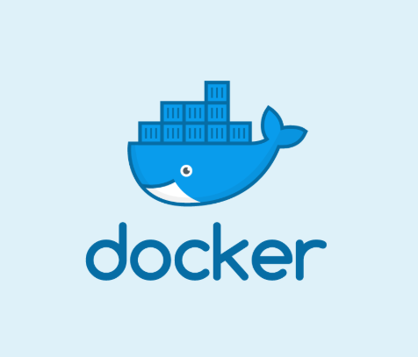
Introduction
Docker is a platform for developers and sysadmins to develop, ship, and run applications by using containers.
Docker helps the user to quickly assemble applications from its components and eliminates the friction during code shipping.
Docker aids the user to test and deploy the code into production.
Notes:
Explain Docker
Docker is a platform for developers and sysadmins to develop, ship, and run applications. Docker lets you quickly assemble applications from components and eliminates the friction that can come when shipping code. Docker lets you get your code tested and deployed into production as fast as possible.

Slide 6
Functionalities
Test the application
Docker provides a platform for the user to:
Develop application and its supporting components using containers
Deploy the application into production environment, as a container or an orchestrated service
Notes:
Explain the functionalities of Docker
The Docker platform
Develop your application and its supporting components using containers.
The container becomes the unit for distributing and testing your application.
When you're ready, deploy your application into your production environment, as a container or an orchestrated service.

Slide 7
Docker Engine
Notes:
moved from lesson 8

Slide 8
Docker Engine
Docker Engine is a client-server application with these major components:
Server: It is a type of long-running program called a daemon process (the dockerd command).
REST API: It specifies the interfaces that programs can use to communicate with the daemon and instructs it on what to do next.
CLI: It is a command line interface client that is used to write the docker commands.
Notes:
Explain Docker Engine and its components
Docker Engine is a client-server application with these major components:
Server: It is a type of long-running program called a daemon process (the dockerd command).
REST API: It specifies the interfaces that programs can use to communicate with the daemon and instructs it on what to do next.
A command line interface (CLI) client (the docker command).

Slide 9
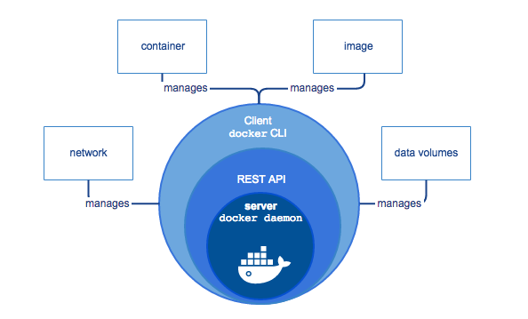
Docker Engine
Source: https://docs.docker.com/engine/docker-overview/#docker-engine
Notes:
Explain the diagram
The CLI uses the Docker REST API to control or interact with the Docker daemon through scripting or direct CLI commands. Many other Docker applications use the underlying API and CLI.
The daemon creates and manages Docker objects, such as images, containers, networks, and volumes.
Note: Docker is licensed under the open source Apache 2.0 license.

Slide 10
Docker Engine
Docker Engine supports the tasks and workflows involved to build, ship, and run container-based applications. The engine creates a daemon process on the server side that hosts volumes of files, containers, networks, and storage.
Docker consists of:
The Docker Engine: It is a lightweight and powerful open source containerization technology combined with a workflow for building and containerizing your applications.
Docker Hub: It is a Software as a Service (SAAS) for sharing and managing your application stacks.
Notes:
Explain the importance of Docker Engine
Docker consists of:
The Docker Engine - our lightweight and powerful open source containerization technology combined with a work flow for building and containerizing your applications.
Docker Hub - our SaaS service for sharing and managing your application stacks.

Slide 11
Docker Properties

Slide 12
Docker Properties
Provides fast delivery of the applications
Is deployable and scalable
Has high density and runs more workloads
Aids in quick deployment for easy management
Notes:
Explain the properties of Docker
Faster delivery of your applications
We want your environment to work better. Docker containers, and the work flow that comes with them, help your developers, sysadmins, QA folks, and release engineers work together to get your code into production and make it useful. We’ve created a standard container format that lets developers care about their applications inside containers while sysadmins and operators can work on running the container in your deployment. This separation of duties streamlines and simplifies the management and deployment of code.
We make it easy to build new containers, enable rapid iteration of your applications, and increase the visibility of changes. This helps everyone in your organization understand how an application works and how it is built.
Docker containers are lightweight and fast! Containers have sub-second launch times, reducing the cycle time of development, testing, and deployment.
Deploy and scale more easily
Docker containers run (almost) everywhere. You can deploy containers on desktops, physical servers, virtual machines, into data centers, and up to public and private clouds.
Since Docker runs on so many platforms, it’s easy to move your applications around. You can easily move an application from a testing environment into the cloud and back whenever you need.
Docker’s lightweight containers also make scaling up and down fast and easy. You can quickly launch more containers when needed and then shut them down easily when they’re no longer needed.
Get higher density and run more workloads
Docker containers don’t need a hypervisor, so you can pack more of them onto your hosts. This means you get more value out of every server and can potentially reduce what you spend on equipment and licenses.
Faster deployment makes for easier management
As Docker speeds up your work flow, it gets easier to make lots of small changes instead of huge, big bang updates. Smaller changes mean reduced risk and more uptime.

Slide 13
Install Docker

Slide 14
Installation of Docker
OS Requirements:
The user must have the 64-bit version of any one of the following Ubuntu versions:
Disco 19.04
Cosmic 18.10
Bionic 18.04 (LTS)
Xenial 16.04 (LTS)
Notes:
Explain the OS Requirements for installation of Docker Community Edition
Use the demo in next slide to give an overview of docker and its use.

Slide 15
Install, Upgrade, and Uninstall Docker CE for Linux
Problem Statement: You have been asked to install Docker Community Edition for Linux. Upgrade it if required and remove it later once your requirement is fulfilled.
Steps to Perform:
Install Docker CE from the Docker repository.
Install Docker CE from the .deb package file.
Upgrade Docker CE using the update command.
Uninstall Docker CE using the purge command.
Notes:
Use this demo to give an overview of docker and its use. Tell learners that all the concepts are going to be covered in the later lessons.

Slide 16
Configure Docker Daemon to Start on Boot
Problem Statement: Your manager has requested you to configure Docker daemon to start the Docker service on system boot to avoid manually starting the Docker service.
Steps to Perform:
Use systemd command to start the Docker service on system boot for Ubuntu 16.04 and higher versions.
Use systemctl command to enable, disable, or reload Docker daemon on system boot.
Navigate to the daemon.json configuration file to configure the daemon flags and environment variables.

Slide 17
Docker Architecture

Slide 18
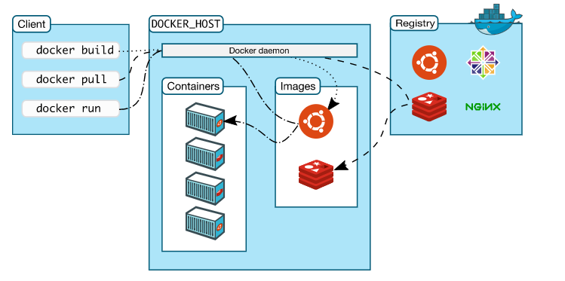
Docker Architecture
Docker uses a client-server architecture. The docker client interacts with the Docker daemon that performs running, heavy lifting of building, and distribution of Docker containers.
Source: https://docs.docker.com/engine/docker-overview/#docker-architecture
Notes:
Explain Docker Architecture
Docker uses a client-server architecture. The Docker client talks to the Docker daemon, which does the heavy lifting of building, running, and distributing your Docker containers. The Docker client and daemon can run on the same system, or you can connect a Docker client to a remote Docker daemon. The Docker client and daemon communicate using a REST API, over UNIX sockets or a network interface.

Slide 19
Docker Architecture
Docker daemon
It accepts the Docker API requests and manages Docker objects, such as images, containers, networks, and volumes. A daemon can also communicate with other daemons to manage Docker services.
Docker client
It is the primary path for Docker users to interact with the Docker application.
Notes:
Explain Docker daemon and Docker client
The Docker daemon
The Docker daemon (dockerd) listens for Docker API requests and manages Docker objects such as images, containers, networks, and volumes. A daemon can also communicate with other daemons to manage Docker services.
The Docker client
The Docker client (docker) is the primary way that many Docker users interact with Docker. When you use commands such as docker run, the client sends these commands to dockerd, which carries them out. The docker command uses the Docker API. The Docker client can communicate with more than one daemon.

Slide 20
Docker Architecture
Docker registries
It stores Docker images. A Docker registry can be of classified into two categories:
Local Registry: It helps the user to pull the image.
Docker Trusted Registry: It is a feature the Docker Enterprise that helps the user to pull the image and scan the image.
Docker objects
When the user uses Docker, in order to package the application and store it in isolated bundles, user creates and uses objects, such as images, containers, networks, volumes, plugins.
Notes:
Explain Docker registry and Docker objects
Docker registries
A Docker registry stores Docker images. Docker Hub is a public registry that anyone can use, and Docker is configured to look for images on Docker Hub by default. You can even run your own private registry. If you use Docker Datacenter (DDC), it includes Docker Trusted Registry (DTR).
When you use the docker pull or docker run commands, the required images are pulled from your configured registry. When you use the docker push command, your image is pushed to your configured registry.
Docker objects
When you use Docker, you are creating and using images, containers, networks, volumes, plugins, and other objects. This section is a brief overview of some of those objects.

Slide 21
Images and Containers
Problem Statement: Your team lead wants you to containerize an existing application into docker images. In order to prepare you for that, first he wants you to get familiar with various aspects of Docker images and containers.
Steps to Perform:
Pull an image from Docker Hub.
Create a new container from image pulled.
Stop the running container.
Delete the container.
Remove the image.
Notes:
This demo will give an overview of how images, container, and other components work.

Slide 22
Docker is a platform for developers and sysadmins to develop, ship, and run applications.
Docker uses a client-server architecture.
The docker client interacts with the Docker daemon that performs running, heavy lifting of building, and distribution of Docker containers.
Docker Engine: Community is supported on x86_64 (or amd64), armhf, arm64, s390x (IBM Z), and ppc64le (IBM Power) architectures.
Notes:
Read the points of key takeaways

Slide 24
Which of the following is NOT a part of the Docker objects?
1
Images
Containers
Repositories
Volumes

Slide 25
Which of the following is NOT a part of the Docker objects?
1
Images
Containers
Repositories
Volumes
c.
The user creates and uses objects, such as images, containers, networks, volumes, and plugins.

Slide 26
Which 64-bit version of the following Ubuntu versions should the user have for OS requirement?
2
Disco 18.04
Disco 19.04
Disco 17.04
Disco 16.04

Slide 27
Which 64-bit version of the following Ubuntu versions should the user have for OS requirement?
2
Disco 18.04
Disco 19.04
Disco 17.04
Disco 16.04
b.
The user should have the 64-bit version of Disco 19.04 for OS requirements.

Slide 28
Which of the following command is used to update the apt package?
3
update apt
sudo apt update
sudo apt-get update
sudo update apt

Slide 29
Which of the following command is used to update the apt package?
3
update apt
sudo apt update
sudo apt-get update
sudo update apt
c.
The command used to update the apt package is sudo apt-get update.

